Slide 1








2026 文藻盃 MyET 團體賽說明會
文藻盃
英該由你發聲 !
不要英藏你的實力 !
Let’s speak up!
Let your Hidden English bloom!
主辦單位：文藻外語大學 英/外語能力診斷輔導中心
電腦版本(Desktop version)

Slide 2







電腦版 Desktop Version
    隊長建立隊伍流程
    Team Leader's Team Creation Process
    隊員加入隊伍流程
    Process for Team Members to Join a Team
    隊長核准隊員加入隊伍流程
    Team Leader Approval Process for Team Members to Join

Slide 3








隊長建立隊伍流程
Team Leader's Team Creation Process

Slide 4
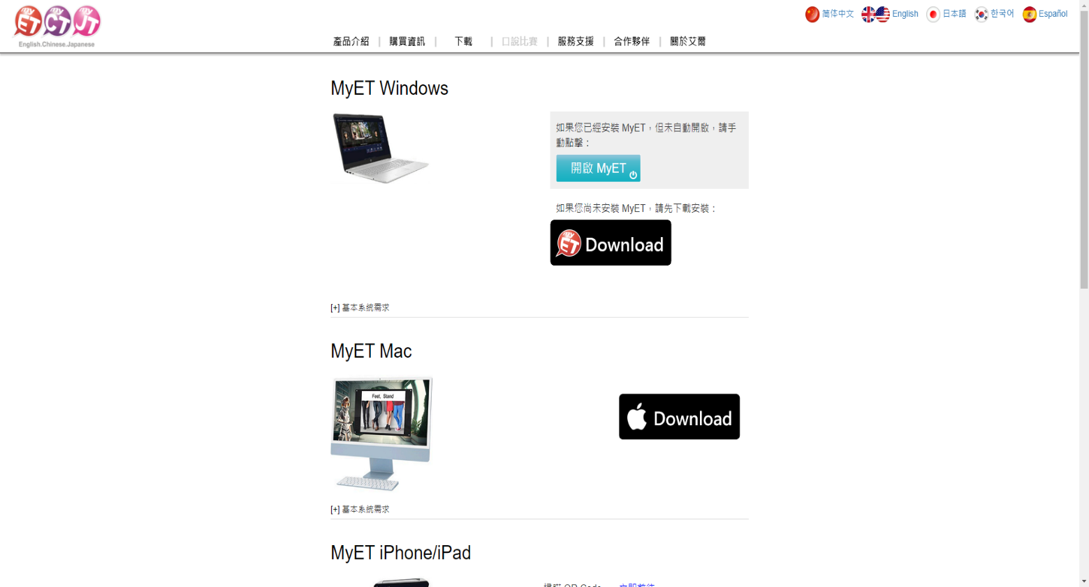



STEP 1
在初賽開始之前，搜尋並下載安裝後開啟MyET APP。
Before the preliminary competition begins, download the MyET app, install and open it.

Slide 5
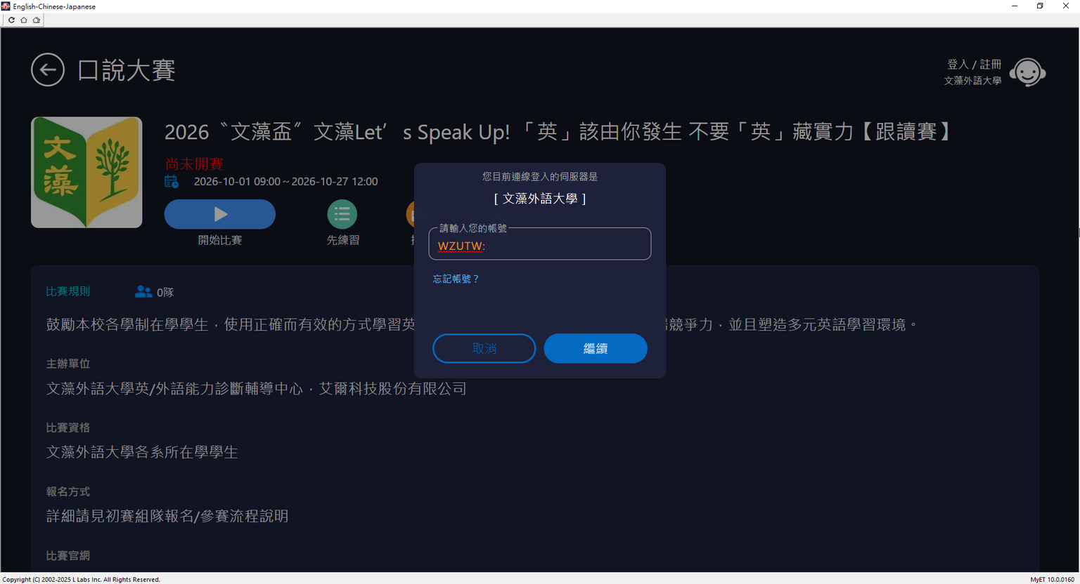



STEP 2
點選右上角「台灣伺服器」，輸入「WZUTW」，進入文藻外大學專屬伺服器。
Click on the upper right corner “Taiwan Server” enter “WZUTW” to access the dedicated server for Wenzao Ursuline University of Languages.
“WZUTW”

Slide 6
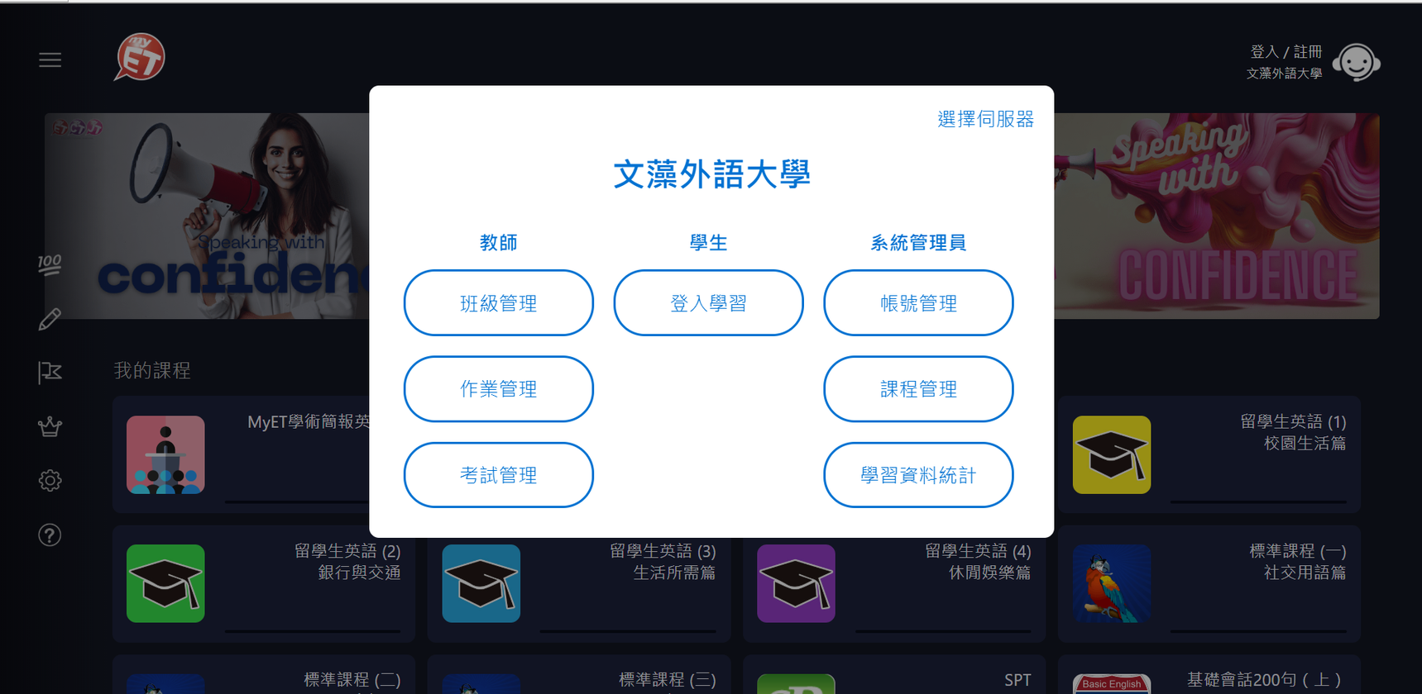


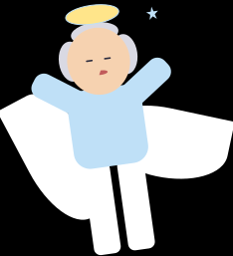
STEP 3
點選「登入」
Click on “Login”
Login

Slide 7
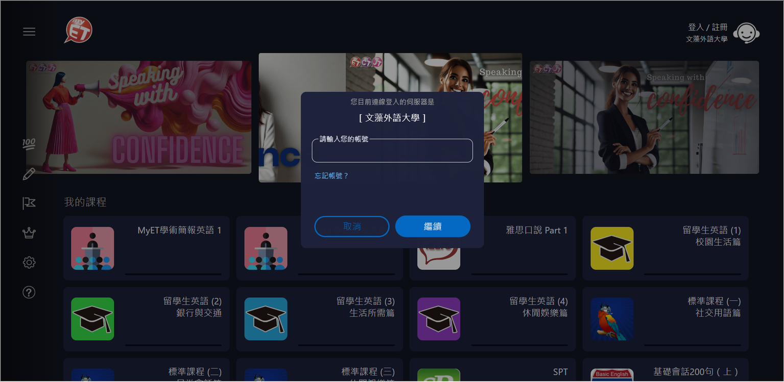
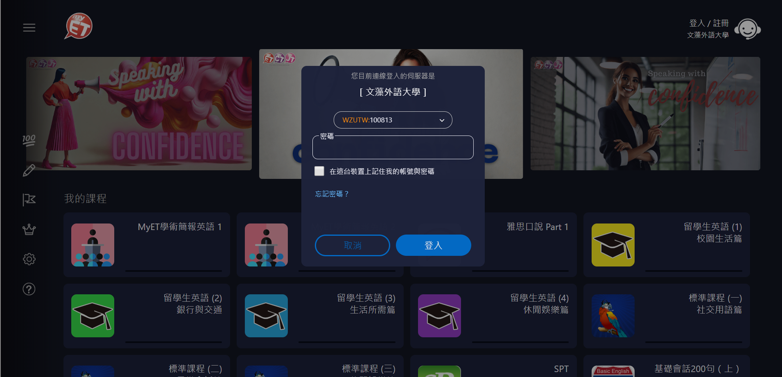



STEP 4
使用個人文藻外語大學資訊服務入口網站的帳號跟密碼登入。
Sign in using your personal Wenzao Ursuline University of Languages Information Service Portal account and password.
Insert your “Account”
Enter your password
學號@st入學年.wzu.edu.tw
Student ID @ st + Year of Admission + .wzu.edu.tw

Slide 8

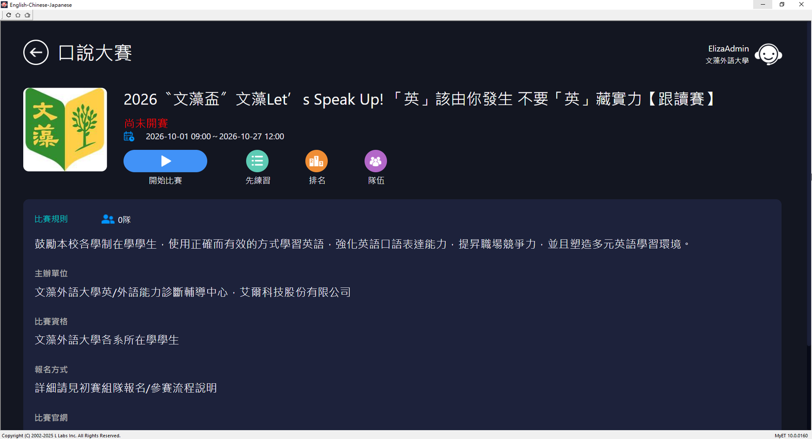


STEP 5
參賽隊伍隊員，在跟讀賽與朗讀賽的比賽介紹頁面，點選〝開始比賽〞按鈕，分別進行跟讀賽與朗讀賽。
Team members should click the “Start Competition” button on the competition introduction pages for the Shadowing and Read Aloud competitions to begin each competition.
Start Competition

Slide 9
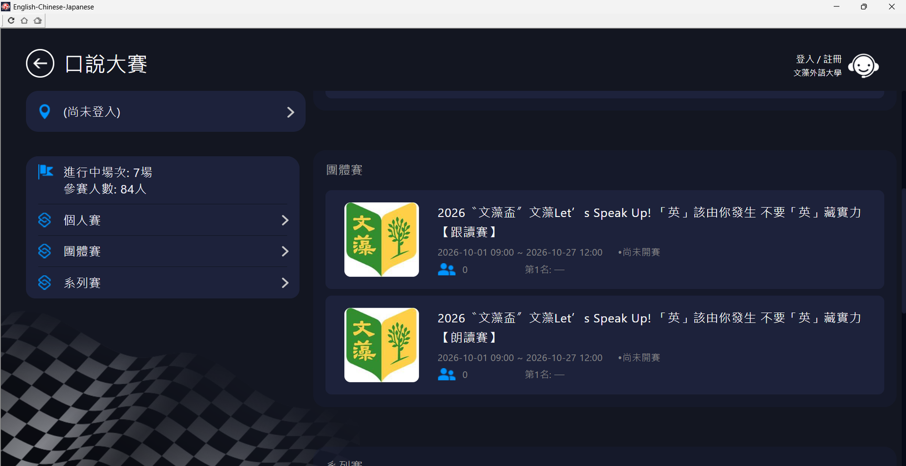



STEP 6
進入「團體賽」頁面，點選「朗讀賽」或「跟讀賽」頁面。
Click “Team Competition” and Click "The Read Aloud Competition” or “The Shadowing Competition”.
The Shadowing Competition
Team Competition
The Read Aloud Competition

Slide 10





STEP 7
請點選右方紫色「隊伍」，進入隊伍列表頁面。
The team leader clicks on “Team” on the right side of the page to enter the team performance page.
Click “Team” button

Slide 11

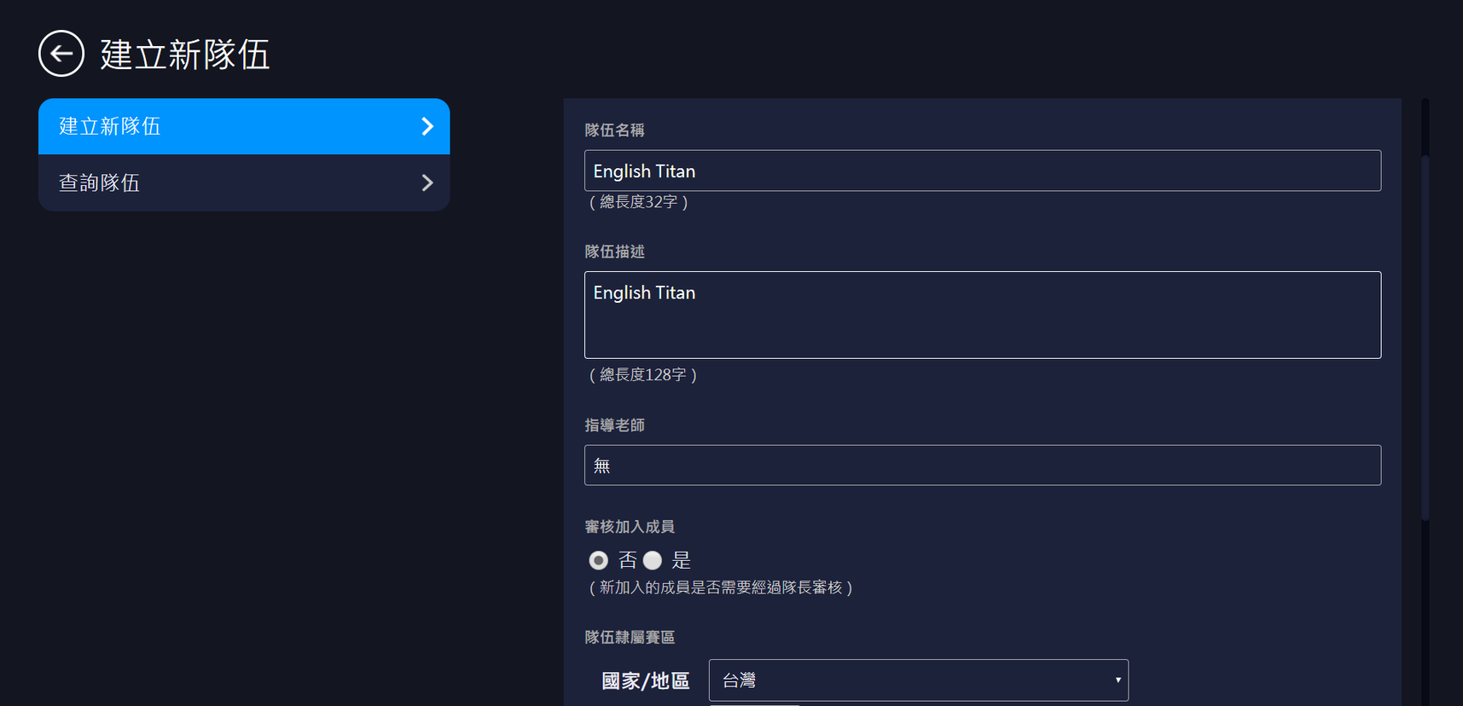


STEP 8
參賽隊伍隊長請點選左上方「建立新隊伍」，每隊隊長加上隊員共兩人，請隊長填寫與報名相同的隊伍名稱等創建隊伍資料。
The team leader should click on “Create New Team” in the top left corner. Each team consists of two members: one team leader and one team member. Enter the same team name and other team information as provided during registration.
Insert "Team Name”
Create new team
Insert “Team Name” again

Slide 12
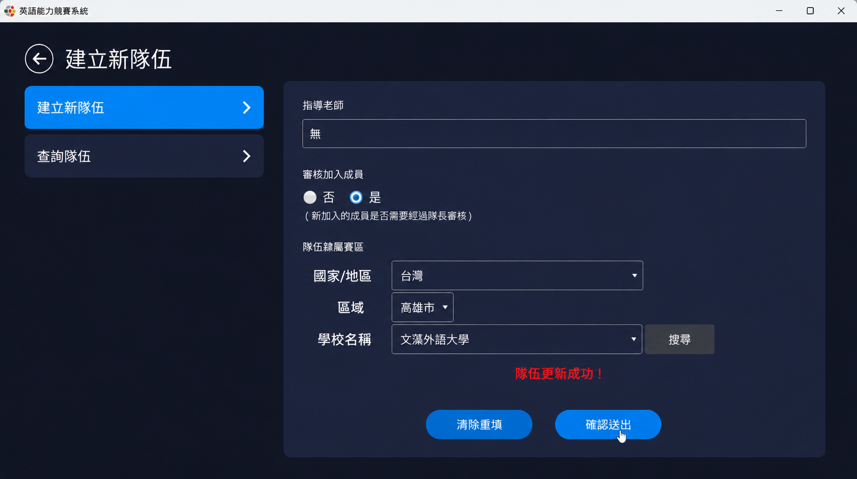



STEP 9
並點選「確認送出」完成創建隊伍，再完成線上報名程序。成功建立隊伍後，請組長自行通知隊員完成加入隊伍流程。
Once the details are filled in, click on “Confirm and Submit” to complete team creation and proceed with the online registration. After successfully create the team, the team leader should notify the members to complete the process of joining the team.
Submit Application

Slide 13






隊員加入隊伍流程
Process for Team Members to Join a Team

Slide 14



STEP 1
在初賽開始之前，搜尋並下載安裝後開啟MyET APP。
Before the preliminary competition begins, download the MyET app, install and open it.

Slide 15



STEP 2
使用個人文藻外語大學資訊服務入口網站的帳號跟密碼登入。
Sign in using your personal Wenzao Ursuline University of Languages Information Service Portal account and password.
“WZUTW”

Slide 16



STEP 3
點選「登入」，使用個人文藻外語大學資訊服務入口網站的帳號跟密碼登入。
Click on “Login” and sign in using your personal Wenzao University Information Service Portal account and password.
Enter your account
Enter your Password
學號@st入學年.wzu.edu.tw
Student ID @ st + Year of Admission + .wzu.edu.tw

Slide 17




STEP 4
進入「團體賽」頁面，點選「朗讀賽」或「跟讀賽」頁面。
Click on “Team Competition” and Click on “The Read Aloud Competition” or “The Shadowing Competition”.
The Shadowing Competition
Team Competition
The Read Aloud Competition

Slide 18
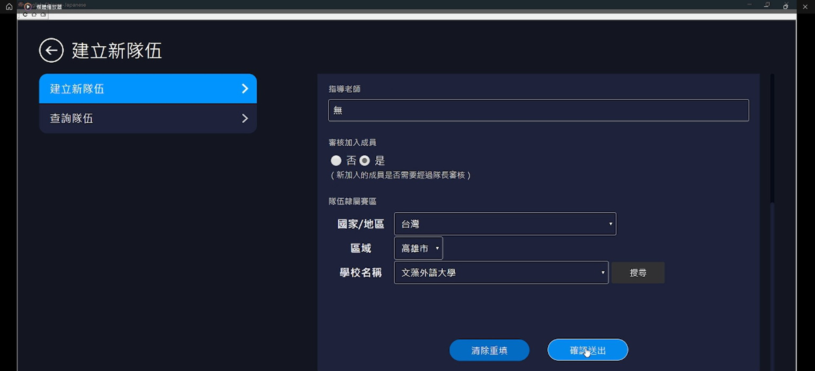


STEP 5
請點選左方藍色「隊伍」，進入隊伍列表頁面。
On the competition introduction page, the team members clicks on “Team” on the left side of the page to enter the team performance page.
Create new Team

Slide 19
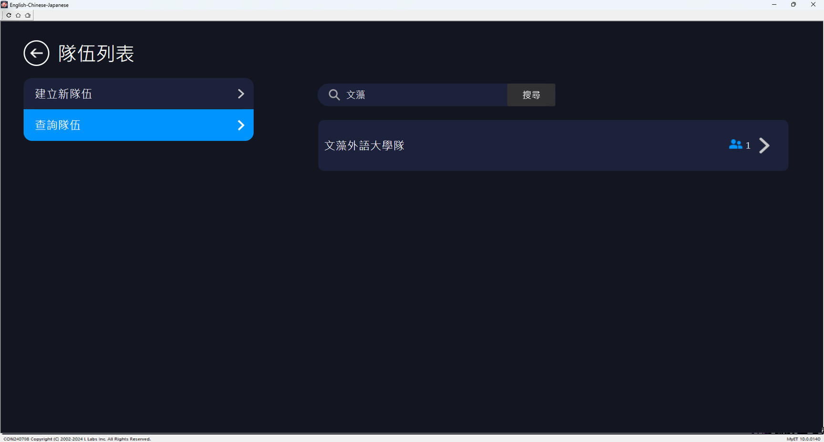
STEP 6
請點選左上方「查詢隊伍」，並在右方搜尋欄位中，輸入隊伍關鍵字，按下搜尋，點選搜尋出現的隊伍名稱，申請加入隊伍。
Please click on “Search Teams” in the upper left corner. In the search field on the right, enter the team name, then press search. Click on the team name that appears in the search results to apply to join the team.
Search the Team
Click on the “Team Name”

Slide 20
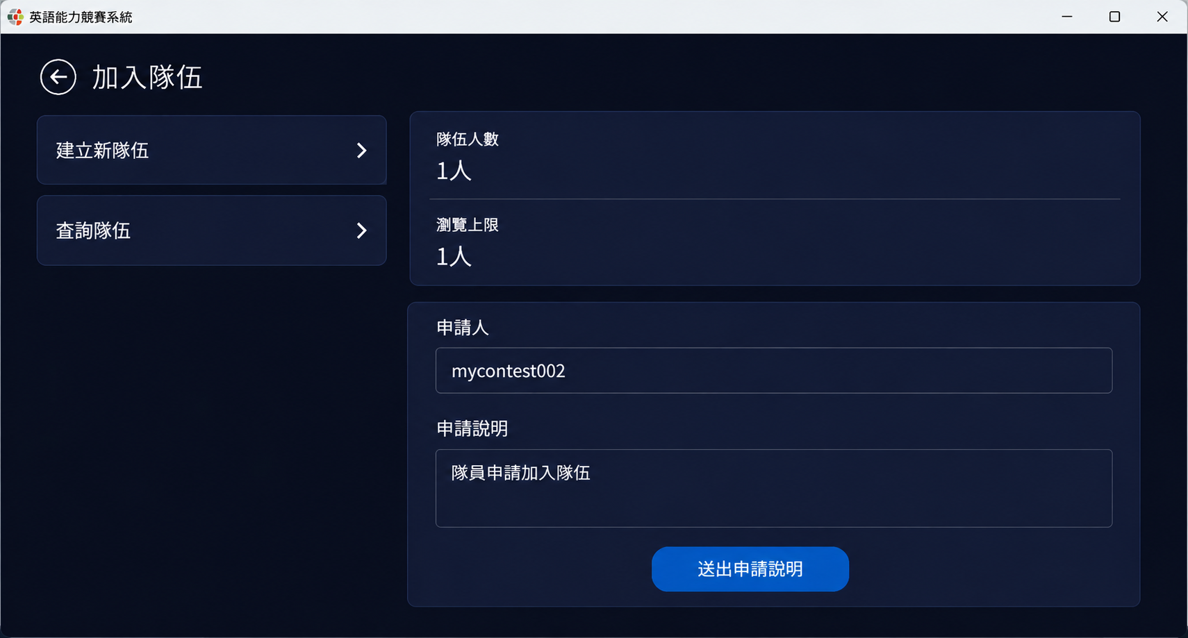
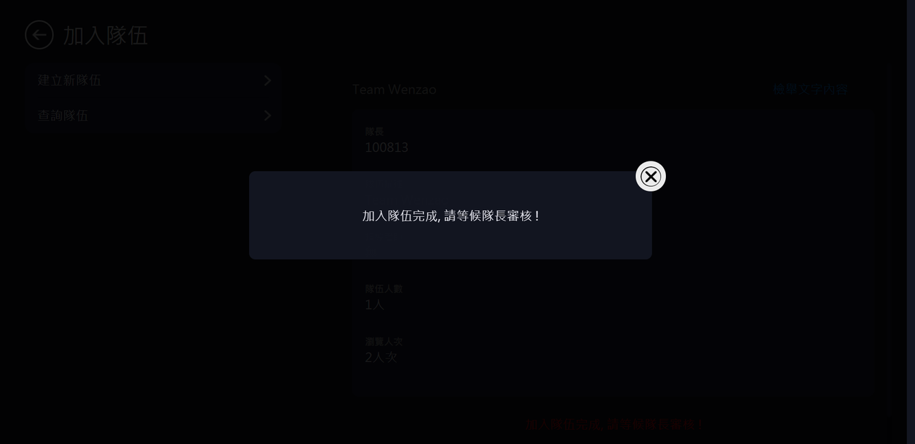

STEP 7
進入隊伍並確認隊伍相關資訊是否正確後，並按下「送出申請說明」，待隊長完成審核隊員申請加入隊伍後，完成加入隊伍流程。
After entering the team and verifying the information and click on “Submit Application.” Wait for the team leader to review your application to join the team to complete the joining process.
Team joined! Awaiting team leader approval !
Submit Application

Slide 21

隊長核准隊員加入隊伍流程
Team Leader Approval Process for Team Members to Join
Notes:
21

Slide 22



STEP 1
請點選左方藍色「隊伍」，進入隊伍列表頁面，成功建立隊伍後，通知
隊員完成加入隊伍流程。
The team leader clicks on “Team” on the left side of the page to enter the team performance page.
Search the "Team"

Slide 23
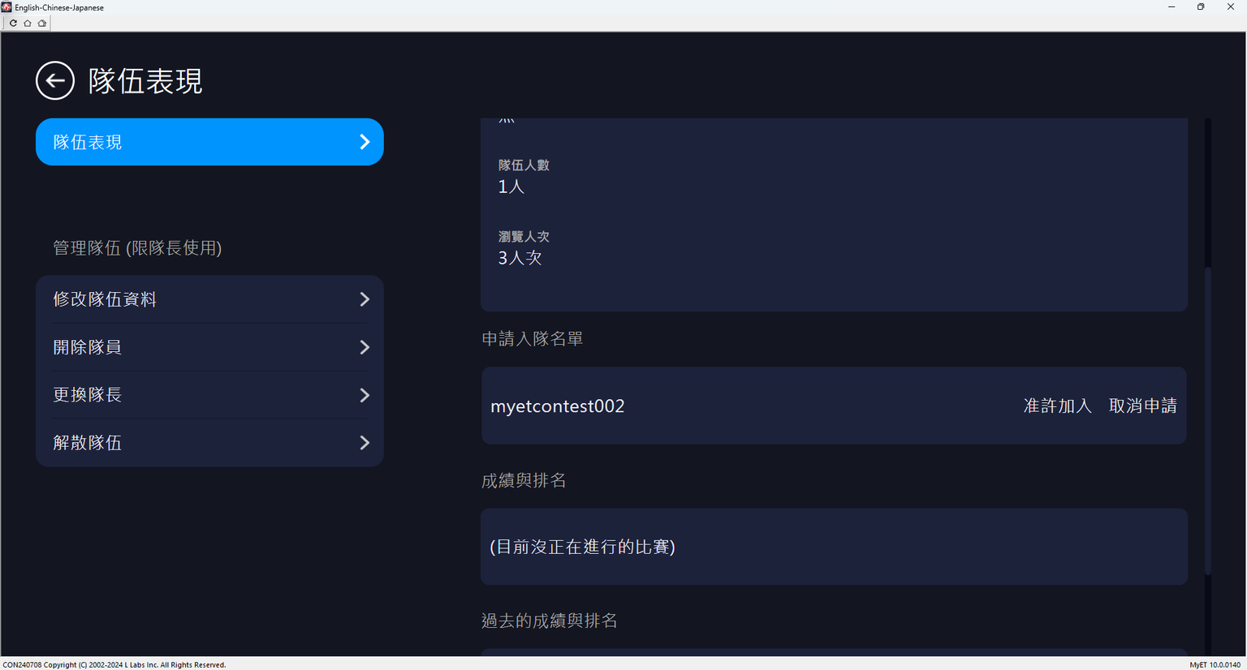
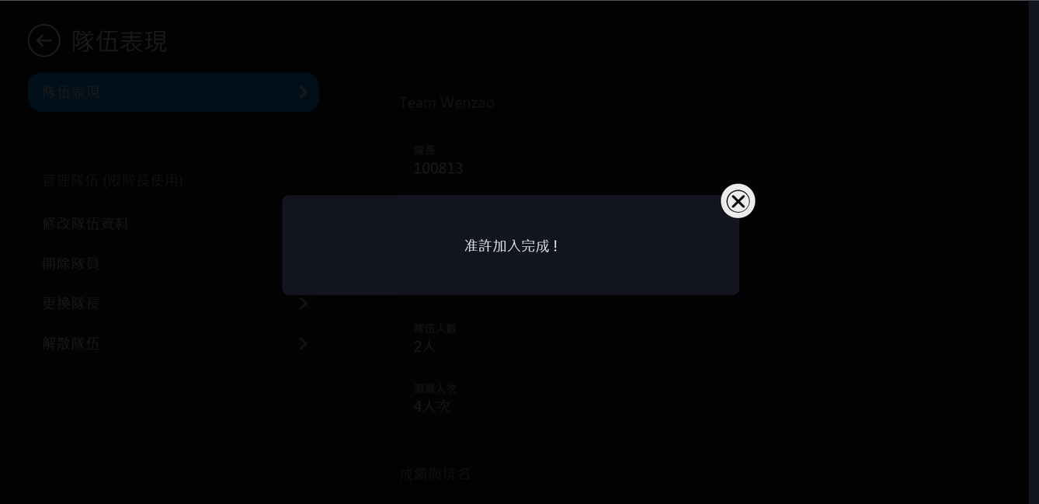



STEP 2
請隊長確認申請加入隊員帳號是否為隊伍隊員，按下「准許加入」，看到准許加入完成訊息，則完成建立隊伍及隊員加入隊伍流程。
The team leader should verify whether the accounts applying to join are the other team member. Once confirmed, press “Approve to Join.” When the confirmation message appears, the team and team members have completed the process.
Complete the approval !
Approved and add

Slide 24







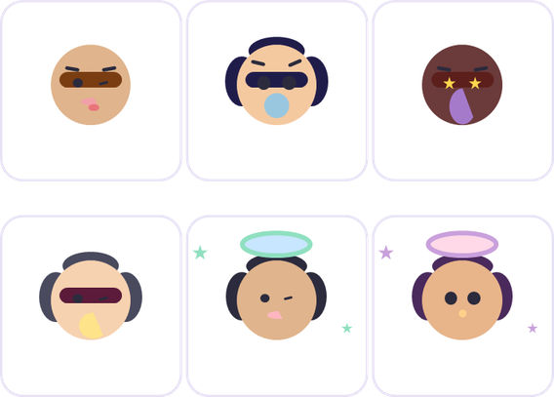
2026 文藻盃 · Let's Speak Up!
THANK YOU
預祝各位參賽隊伍榮獲佳績！
如有任何疑問，歡迎洽詢英/外語能力診斷輔導中心（分機 7403）

